Slide 1



Supervised Learning Regression
INTRODUCTION TO MACHINE LEARNING
- Ashwina Rakish

Slide 2
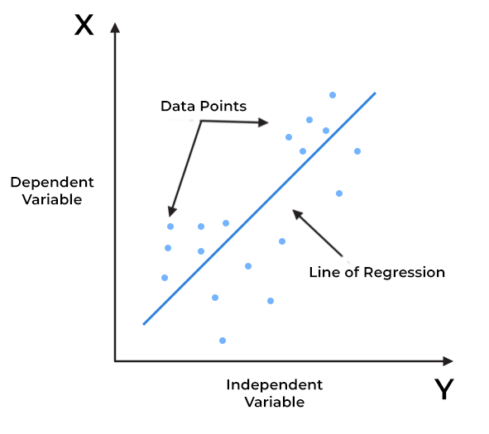
Regression
A regression is a statistical technique that relates a dependent variable to one or more independent (explanatory) variables.
A regression model is able to show whether changes observed in the dependent variable are associated with changes in one or more of the explanatory variables.

Slide 3
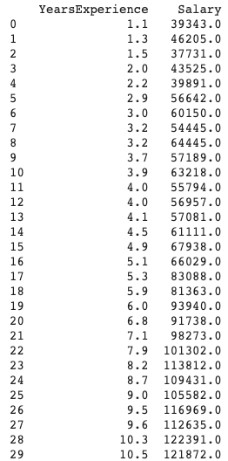
x | y
1 | 6
2 | 12
3 | 17
4 | 25

Slide 4
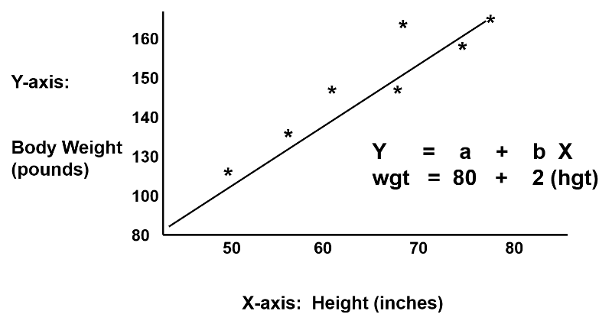

Simple Linear Regression
Simple linear regression helps model relationships between dependent variable and a single independent variables.
Here,
y is the predicted value
X is the independent variable
β_{ο} is the intercept
β₁ is the regression coefficient
ε is the random error

Slide 5
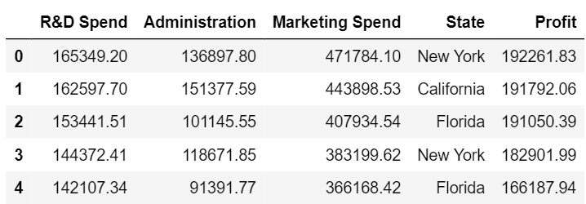

Slide 6

Multiple Linear Regression
A multiple linear regression helps model relationships between dependent variable and multiple independent variables.
The values of the regression coefficients are found by minimizing loss function.
Here,
y is the predicted value
x_{i} is the independent variable
β_{ο} is the intercept
β_{i} is the regression coefficient
ε is the random error

Slide 7
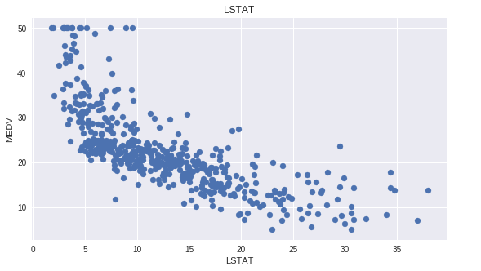

Slide 8
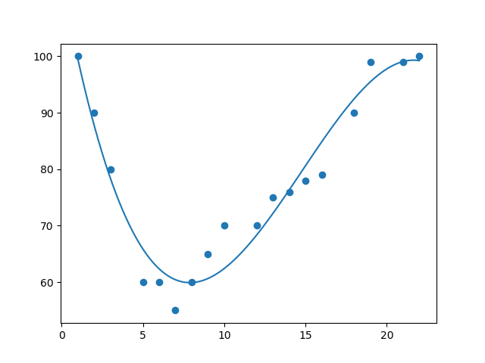

Polynomial Regression
Here,
y is the predicted value
x_{i} is the independent variable
b_{ο} is the intercept
b_{i} is the regression coefficient
ε is the random error

Slide 9
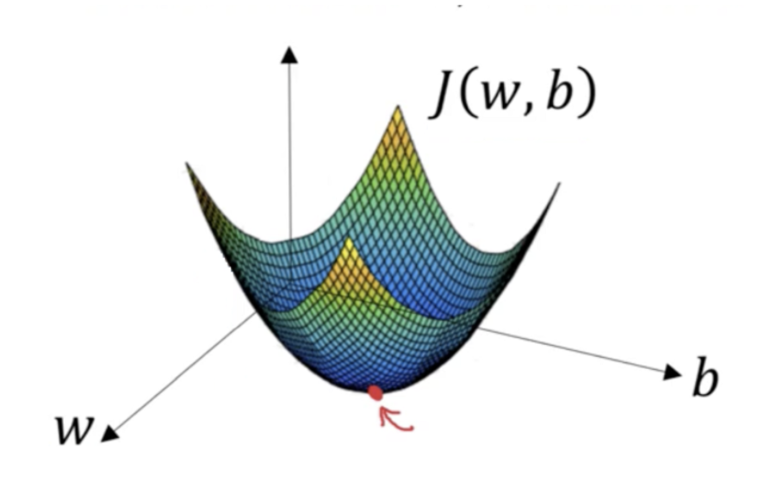
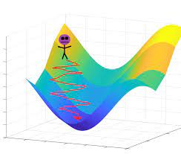
Gradient Descent
Gradient descent is an optimization algorithm used to minimise the loss function by finding the minima.
A gradient simply measures the change in all weights with regard to the change in error.

Slide 10
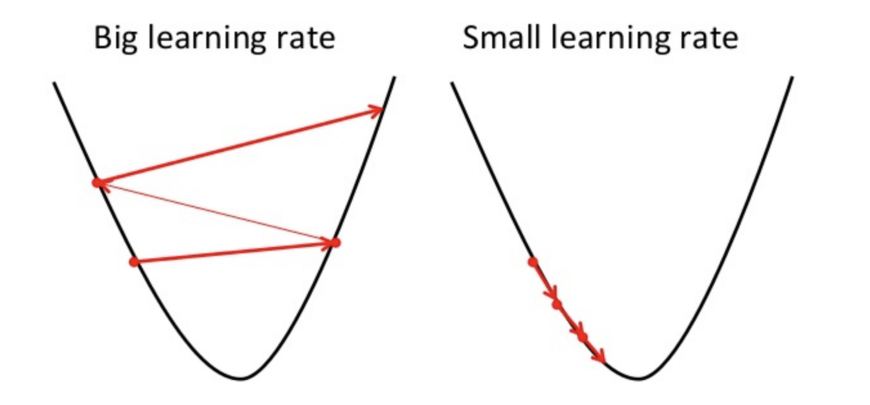
Gradient Descent
Learning rate decides how much the weights are adjusted in each iteration.

Slide 11
QUIZ

Slide 12
Question: In simple linear regression, how much does y change for every unit change in x?
Answer: β₁

Slide 13
Question: In gradient descent will it take longer with small learning rate or a larger one?
Answer: Small

Slide 14
Question: What would happen if learning rate is infinitesimally small?
Answer: Model won’t converge

Slide 15
Thank You!

